Slide 1
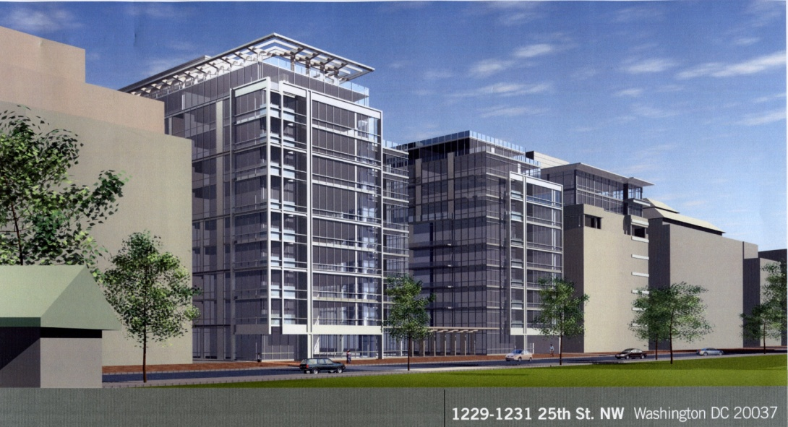
WestEnd25
Charles Miller– 2009 AE Senior Thesis
Construction Option - Riley

Slide 2
Outline
WestEnd25 Background
Concrete Placement
Precast Façade
LEED
Conclusions
Acknowledgements
Questions

Slide 3
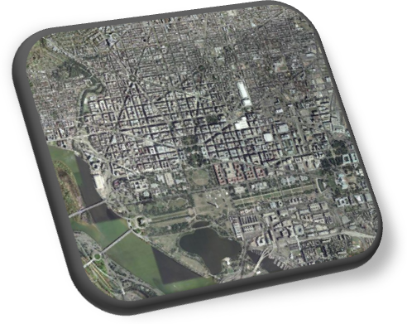
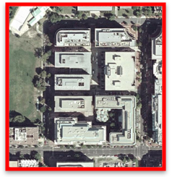
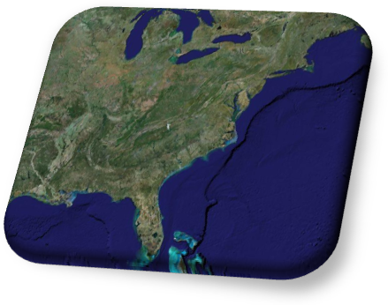
Project Background
Function: Residential Apartments
Size: 324,000 sq. ft. / 10 stories
Project Cost: $76 Million
Construction Period: March 2007 – January 2009
Owner: Vornado - Charles E. Smith
Contractor: James G. Davis Construction
Architect: Shalom Baranes Associates Architects
WestEnd25

Slide 4
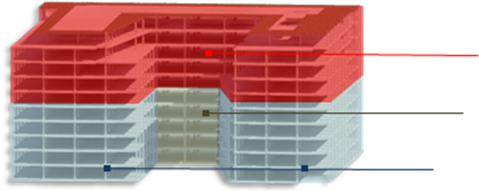
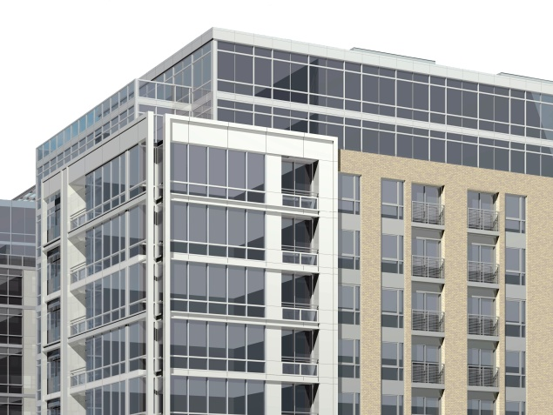
Project Background
Existing:
Two 6 story office buildings
Precast Façade
Concrete Structural System
New Construction:
One 10 story apartment building
Curtain wall and Brick Facade
Concrete Structural System
Structural Concrete Slabs:
Added Levels: 6” Post-Tensioned
Exterior Façade:
Connection: 7.5” Post-Tensioned
Metal Panels
Brick Facade
Curtain Wall
Existing: 7.5” Conventionally Reinforced

Slide 5
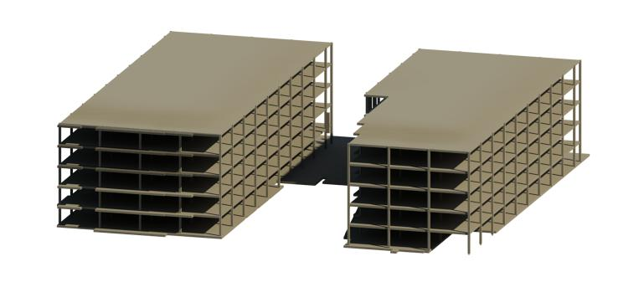
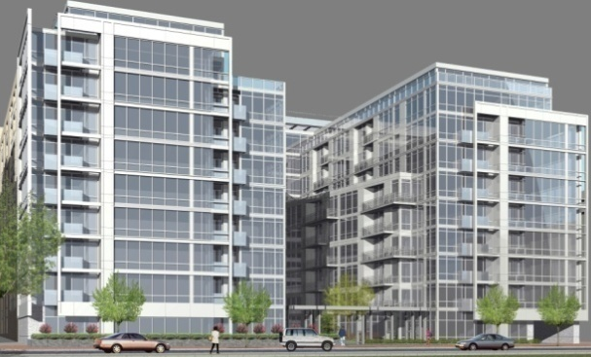
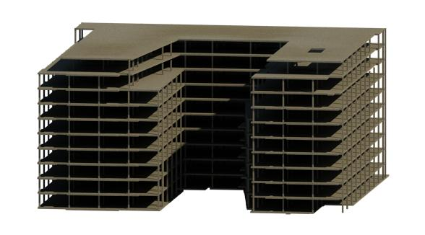
Concrete Placement
Structural System:
Existing:
6 Stories Concrete
Placement Method:
Crane and Bucket
Suggested Placement:
Concrete Pump
Faster Installation
Schedule
Cost
New Construction:
6 Connectors
4 Stories Concrete

Slide 6
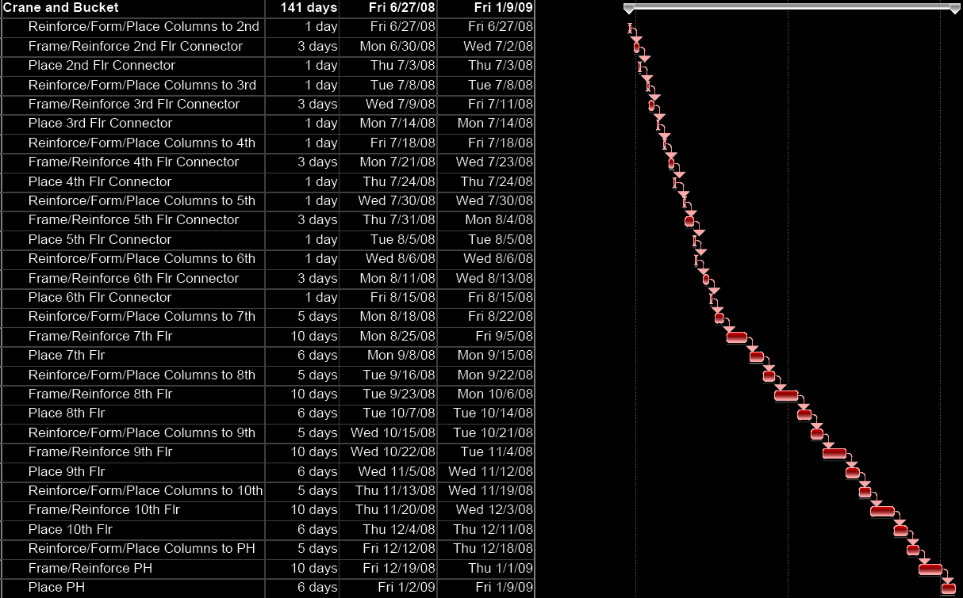
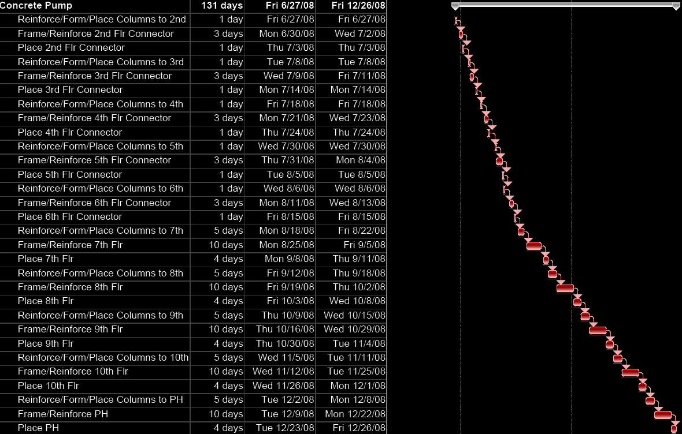
Concrete Placement
Schedule Comparison:
Same Connector Slab Duration
Pump Saves 2 Days per Full Slab

Slide 7
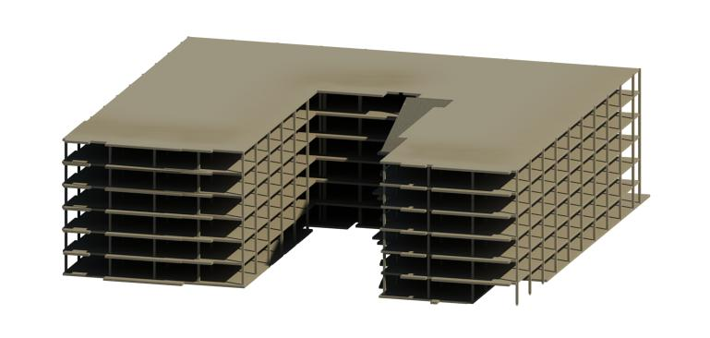
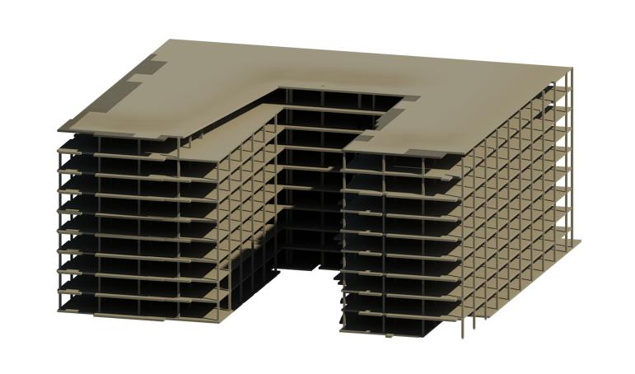
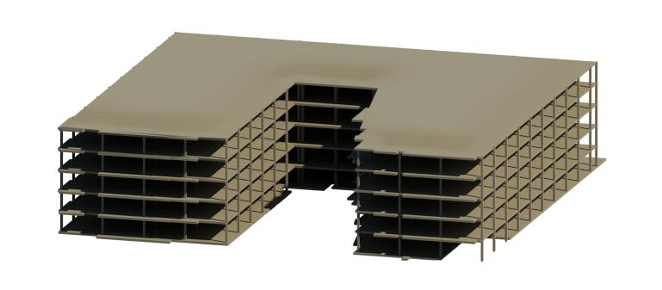
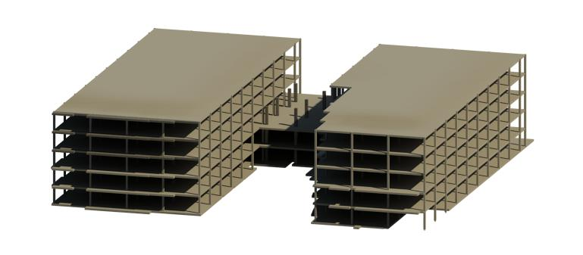
Concrete Placement
Placement Schedule Effects Timeline:
Crane and Bucket:
7/1/08
8/1/08
9/1/08
10/1/08
11/1/08
12/1/08
1/1/09
7/3/08
8/15/08
10/8/08
10/14/08
4 Days
12/1/08
8 Days
12/11/08
10 Days
7/18/08
12/26/09
1/9/09
7/1/08
8/1/08
9/1/08
10/1/08
11/1/08
12/1/08
1/1/09
Pump:

Slide 8
Concrete Placement
Cost:
Conclusion:
Connecting Slabs Limit Efficiency
Pump Benefits on Full Slabs
Limited Overall Savings
Familiar but slower method is acceptable
Item | Quantity | Cost Basis | Total Cost
Crane and Bucket Placement | 4,106 CY | Equipment = $7,000/week Labor = $13/ CY | $193,375
Pump Placement | 4,106 CY | $18.20/ CY | $74,750
 |  | Cost Difference | $118,625
Supplemental Crane: |  | $650/day For 131 days | ($85,150)
 |  | Net Savings: | $33,475
General Conditions Savings |  | $5,925/day For 10 days | $59,250
 |  | Total Savings: | $92,725
Potential savings of $92,725
.12% of Project Cost

Slide 9
Façade Analysis
Original Façade
Precast
Specified Façade
Brick Cavity Wall
Poor Slab Edges
Precast Façade
Schedule
Cost
Thermal Performance
Structural Loads

Slide 10
Façade Analysis
Precast Benefits:
Faster Installation
Less Delays due to Weather
Productivity Analysis
CE 533 – Construction Productivity Analysis and Performance Evaluation
Activity in Progress
Analysis Expectations
Late Winter Weather Delays
Report Quantities
Report Workhours
Calculate Productivity
Performance Evaluation

Slide 11
Façade Analysis
Productivity Chart
3 Peaks of Decreased Productivity
One Weather Related
Two Delays from Other Trades Uncompleted Work
Data Point Majority Below Baseline
Better than Expected Productivity
Analysis Shows Limited Benefits due to Weather Delays
= Weather Delay
= Other Trade Delay

Slide 12
Façade Analysis
Brick Sequencing:
1st floor North
1st floor East
1st floor South
2nd floor North
2nd floor East
Etc…
Precast Sequencing:
North Facade
East Facade
South Facade
Schedule Comparison:

Slide 13
Façade Analysis
Cost:
Item | Quantity | Cost Basis | Total Cost
Brick Façade | 23,030 sq. ft. | Budget Estimate: Labor = $489,000 Material Estimate = $416,000 Equipment = $131,250 | $1,036,250
Precast Facade | 23,030 sq. ft. | $35/sq.ft. | $806,050
Difference: |  |  | $230,200
Demolition Extra Work: |  |  | $77,000
Total Savings: |  |  | $307,200
Conclusion:
Cost Savings Must be Weighed Against Risk of Difficult Installation
Feasibility Depends on Crew

Slide 14
Façade Analysis
Precast Façade:
Traditional Brick Façade:
U-Value Comparison
Coefficient of Heat Transfer
Lower Value Better
Precast Option is Thermally Feasible
Layer | R - Value ((hr*ft²*ºF)/Btu )
Exterior Air Film | 0.17
6” Concrete | 0.60
2” Rigid Insulation | 10.00
5/8” Gypsum Board | 0.56
Framing Cavity | 9.0
1/2" Gypsum Board | 0.45
Interior Air Film | 0.68
Total | 21.46
U-Value | 0.047
Layer | R – Value ((hr*ft²*ºF)/Btu )
Exterior Air Film | 0.17
4 in. Face Brick | 0.80
1.5” Air Space | 0.93
2” Rigid Insulation | 10.00
5/8” Gypsum Board | 0.56
Framing Cavity | 9.0
1/2” Gypsum Board | 0.45
Interior Air Film | 0.68
Total | 22.59
U-Value | 0.044

Slide 15
Façade Analysis
Structural Analysis
pca Column
Precast Structurally Feasible
Load | Calculation | Total
Panel | 150lbs/ft³(.5ft)(1ft)(10.6ft)=795lbs/ftwidth 795lbs/ftwidth(12ftwidth) | 9,540 lbs
Concrete | (0.625ft)(150lb/ft³)=93.75lbs/ft² 93.57lb/ft²(200ft²)+(22.5ft³)(150lbs/ft³) | 22,089 lbs
Wind | 43psf(1ft)(10.6)=455.8lbs/ftwidth 455.8lbs/ftwidth(12ftwidth) | 5,469.6 lbs
Floor | 40psf + 20psf =60psf 60psf(200 ft²) | 12,000 lbs

Slide 16
Façade Analysis
Façade Conclusion
Thermal Analysis and Structural Analysis Prove the Precast Façade is Feasible
Cost Savings Must be Weighed Against Risk of Difficult Installation
Feasibility Depends on Crew

Slide 17
LEED
Critical Industry Issue: 2008 PACE Roundtable Breakout Session: LEED Evolution
Increase Owner Involvement
Interviews of Industry Professionals
Series of Open Ended Questions
Interesting Results

Slide 18
LEED
What do owners need to do differently?
Few Felt that Owners Need to Increase Knowledge Base
Owners Need to Accept Costs and Improve Integration

Slide 19
LEED
What mistakes do owners typically make that cause problems for a project attempting a LEED Certification?
Indecisiveness is a Major Problem
Owners Need to Set Clear Goals and Maintain Sustainability Commitment
Indecisiveness is a Larger Problem than Accepting Costs

Slide 20
LEED
What do owners do that is successful and helps the overall project?
Successful Owners Clearly State Sustainability Goals and Maintain Their Commitment to Sustainability

Slide 21
LEED
How important is the selection of a design professional that has experience and expertise with sustainable design?
All Participant Indicated Importance of Sustainable Experience
63% Indicated a Level of “Extreme” Importance

Slide 22
LEED
What design decisions are typically passed over without early owner commitment to LEED?
Owners Typically Own Land Before Deciding to Build

Slide 23
LEED
Research Findings
Changes/Waiting Deterrent
Clear Goals and Commitment
Designer Critical

Slide 24
Summary
Concrete Placement
Familiar but Slower Concrete Placement Method is Acceptable
Façade Analysis
Thermal Analysis and Structural Analysis Prove the Precast is Feasible
Cost Savings Must be Weighted Against Risk of Difficult Installation
LEED
Research Findings
Changes/Waiting Deterrent
Clear Goals and Commitment
Designer Critical

Slide 25
Acknowledgments
Vornado/Charles E. Smith
James G. Davis Construction
AE Faculty
Survey Participants
Family & Friends

Slide 26
Questions?

